Slide 1

Device Switch using Power Line Communication
Presented by:
Chinmay Jadhav | Parth Katkar | Harshal Kolhe | Taraka Phadke
Roll No: 07 | Roll No: 11 | Roll No:14 | Roll No:27
Guided by :
Prof. Yogesh Karunakar.
Department of Electronics & Telecommunication Engineering
K. C. College of Engineering & Management Studies & Research
(Affiliated to the University of Mumbai)
Mith Bunder Road, Near Hume Pipe, Kopri, Thane (E)-400603

Slide 2
KCCEMSR, THANE OUTLINE OF PRESENTATION
Sr. No. | Content
1 | Introduction
2 | Literature Survey
3 | Problem Statement
4 | Objective of Study
5 | Methodology
6 | Components and tools to be used
7 | Application
8 | Conclusion & Future Scope
9 | References

Slide 3
INTRODUCTION
1. The Power Line Communication is the method of transferring power and data for communication through the same existing network of wires from one end to the other end. This can be done through the home or premises wiring and may also be done through the existing electric power distribution system.
2. It provides broadband data communications on conductors which are already in use for the transmission of electric power using a modular signal.
3. The wide range of power-line communication technologies are needed for different applications, ranging from home automation to Internet access which is often called broadband over power lines (BPL).

Slide 4
LITERATURE REVIEW
Paper No. | Year | Author | Literature
Paper 1 | 2012 | Jovita Serrao et al. | General and technical reference to transmission of data using a power line carrier communication system
Paper 2 | 2012 | Nitesh Kumar Jangir | Project proposes to use Power lines as a medium to carry control data to control a load
Paper 3 | 2014 | Abdul Mannan et al | PLC is an emerging home network technology that allows consumers to use their already existing wiring system to connect home appliances to each other and to the Internet

Slide 5
PROBLEM STATEMENT
When appliances are working on generator, AC consumes more electricity and generator doesn't last for longer time.

Slide 6
PROJECT OBJECTIVE
The project involves the design and development of selective remote control system over AC power lines as the communication channel. The system will be designed around the STM 32 board.
The system will be designed to operate with single phase power line. For interface with Three- phase power lines, only the line interface circuit needs to be modified using three phase transformer.

Slide 7
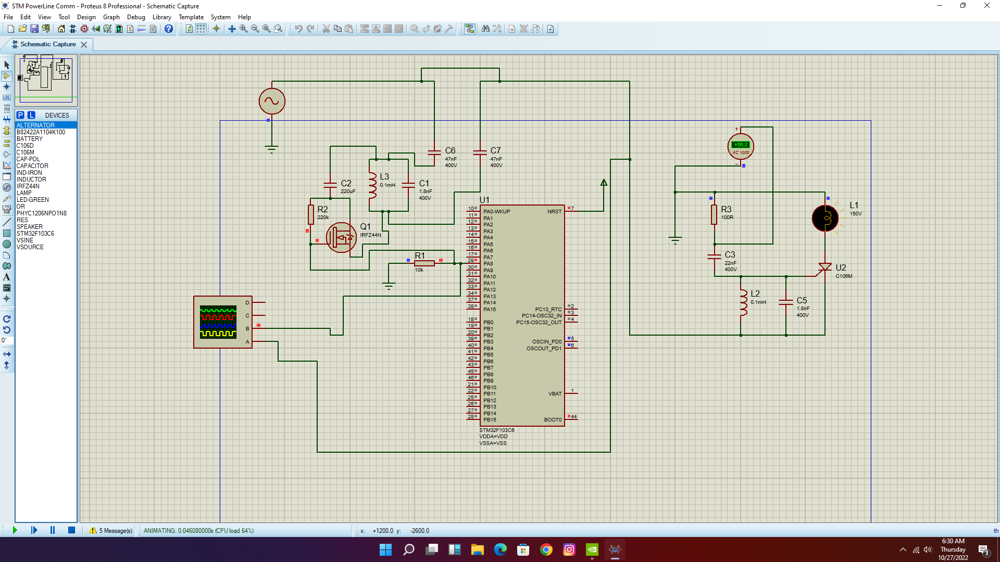
CIRCUIT DIAGRAM

Slide 8
WORKING
We are using STM32 board for generation of PWM signal. The PWM signal is then applied to the Line tuner. Line tuner is suitable matching unit.
The signal is then transmitted through the coupling capacitor. It protects the PLC equipment from low frequency, high voltage signal by acting as a High Pass filter. But it allows high frequency power signals to pass through it.
Signal is transmitted through the power line to the receiver end. In this process wave trap protects the electrical substances from high frequency communication signals by acting as a low pass filter. It opposes the signal to enter into the switch yard.
At the receiver, the coupling capacitor acts as High pass filter, it allows high frequency power signals to pass through it.

Slide 9
WORKING
The high frequency signal transmitted by the transmitter is received to the receiver.
Receiver has LC circuit, which starts resonating when high frequency signal is received.
When the Gate of the C106M gets some triggered voltage, it start working as a short circuit.
Because of high frequency signal, LC circuit triggers the gate of the C106M, and the load is turned on.
When signal is not received the gate of C106M is not triggered and the load remains in off condition.

Slide 10
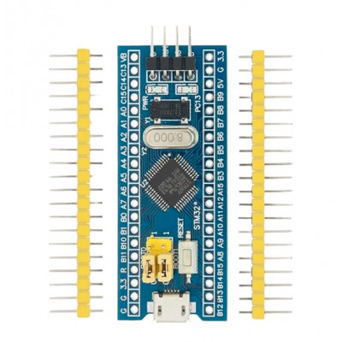
COMPONENTS
STM 32 F103C6

Slide 11
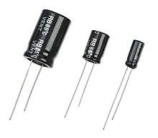
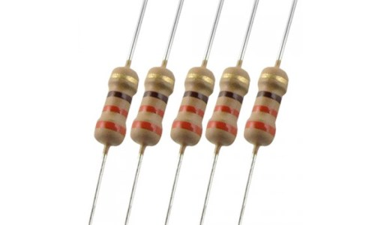
COMPONENTS
Capacitor
Registor

Slide 12
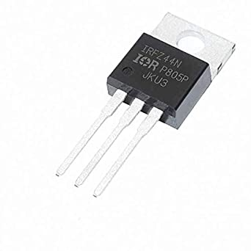
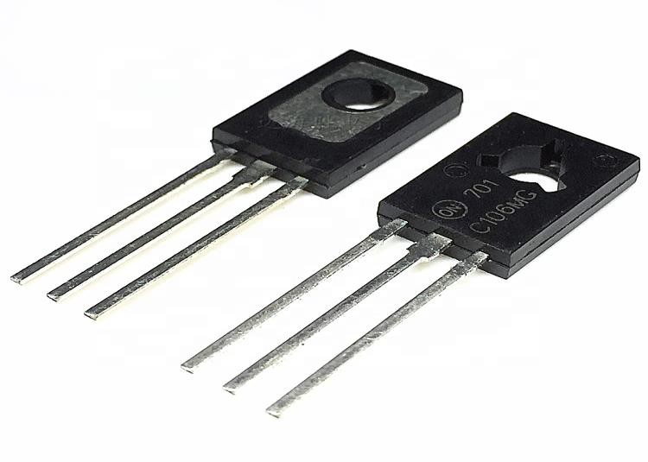
COMPONENTS
IRFZ44N
C106M Thyristor

Slide 13
APPLICATIONS
For Automation and control of electrical equipments .
Lighting Applications - For traffic light control, LED dimming etc.
Industrial Applications - For Irrigation control etc.
Machine-to-Machine Applications - For Air conditioner’s and Vending Machines
Transport Applications - For Electronics in cars, trains, and airplanes and many more.

Slide 14
ADVANTAGES
Low Implementation Cost
Large Reach
Lower Running Cost
Indoor High Speed

Slide 15
LIMITATIONS
. Low transmission speed over long distance
Sensitive to disturbance
Nonlinear distortion and Cross-modulation between channels

Slide 16
CONCLUSION
No separate wires are needed for communication purposes, as the power lines themselves carry power as well as communication signals. Hence the cost of constructing separate telephone lines is saved.
When compared with ordinary lines the power lines have appreciably higher mechanical strength. They would normally remain unaffected under the conditions, which might seriously damage telephone lines.
Power lines have large cross-sectional areas resulting in very low resistance per unit length. Consequently the carrier signals suffer much less attenuation than when they travel on usual telephone lines of equal lengths.

Slide 17
FUTURE SCOPE
Results from the validation should lead to improved design, in terms of cost, performance, and energy requirements for the PLCC receiver and continuous carrier transmitter, as well as detailed simulation of carrier propagation in a number of different environments and scenarios.
Greater research in the area of transmission of digital signals over power lines will definitely enable us to come up with various applications of the concept.
This will of course require us to update the hardware associated with the power lines as now we will have to include routers at transformer sections.
Protocols and standards for the same will have to be developed if this technology has to be implemented on a commercial scale.
Internet access could also be made possible by the setting up of Wi-Fi Routers at areas close to transformers.

Slide 18
REFERENCES
https://www.researchgate.net/publication/239762728_Low_Complexity_Turbo_Code_Specification_for_Power-Line_Communication_PLC
https://circuitdigest.com/article/what-is-power-line-communication-plc-and-how-does-it-work
https://repository.najah.edu/bitstream/handle/20.500.11888/11737/power_line_communication.doc?sequence=1&isAllowed=y

Slide 19
KCCEMSR, THANE
Thank You!!

